Slide 1
E-commerce Website Project
An Introduction

Slide 2
Project Overview
My College project is focused on creating a fully functional e-commerce website using HTML, CSS, JavaScript, and various other technologies. This presentation will provide an overview of our project.

Slide 3
Key Features [In Work & Testing]
Our e-commerce website will include a range of features, such as user registration, product catalog, shopping cart, secure payment processing, and more. We aim to create a seamless shopping experience for our users.

Slide 4
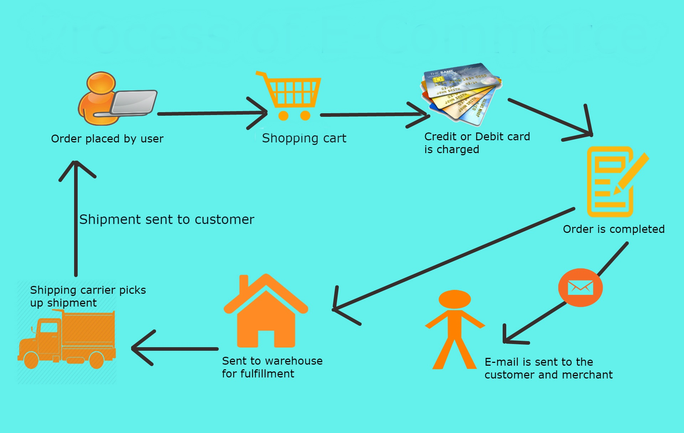
The Process Of E-commerce

Slide 5
Technologies Used
We have utilized a combination of HTML, CSS, JavaScript, and other web development technologies like PHP to build our e-commerce website. Additionally, we have incorporated responsive design principles for optimal performance and make the website responsive for various devices.

Slide 6
Now lets try to understand how the data flows in this system

Slide 7
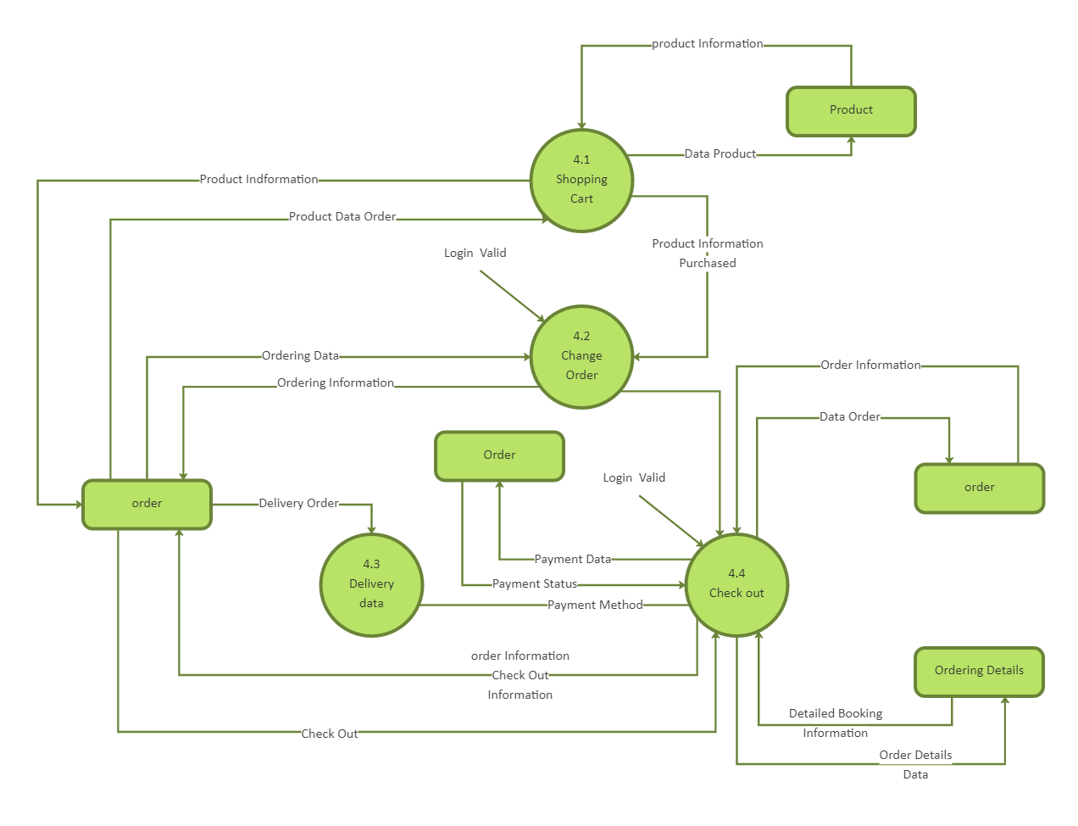

Slide 8
Advantages of E-commerce Website
1. E-commerce websites provide a global reach, enabling businesses to reach customers worldwide.
2. They offer 24/7 accessibility, allowing customers to shop at their convenience.
3. E-commerce reduces overhead costs and simplifies inventory management.
4. Data analytics tools offer insights for targeted marketing and personalized shopping experiences.
5. E-commerce platforms can easily adapt and scale to market trends and customer demands.

Slide 9
Creating an e-commerce website can come with several challenges, Lets go through them one by one

Slide 10
Payment Gateway Integration: Integrating secure and reliable payment gateways can be complex, and any issues can lead to payment processing problems.
User Experience: Designing an intuitive, user-friendly interface is crucial for e-commerce. Poor navigation and a confusing layout can deter customers.
Content Management: Updating product listings, images, and descriptions regularly requires an efficient content management system.
SEO and Marketing: Gaining visibility and traffic requires effective SEO strategies and marketing efforts, which can be time-consuming and competitive.

Slide 11
Technical Issues: Developing a stable and secure platform can be challenging, as it requires expertise in web development, database management, and ensuring the site can handle traffic spikes.
Security Concerns: E-commerce websites are attractive targets for cyberattacks. Ensuring robust security to protect customer data is essential.
Inventory Management: Keeping track of inventory, particularly for businesses with a wide range of products, can be challenging to avoid overselling or stockouts.
Scalability: As the business grows, the website must be able to scale to accommodate increased traffic and transactions.

Slide 12
Conclusion
In conclusion, our e-commerce project represents the culmination of my web development skills. I am excited to showcase my website and demonstrate how it can enhance the online shopping experience for users. Thank you for your attention.

